Slide 1


Plane Table Survey
Unit-VI

Slide 2




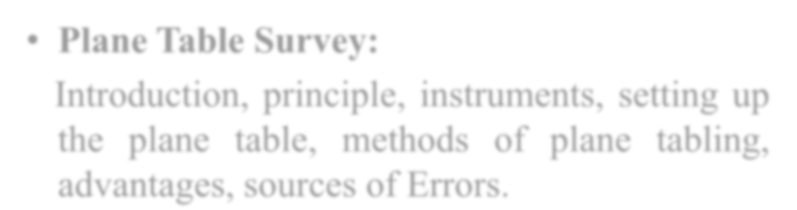

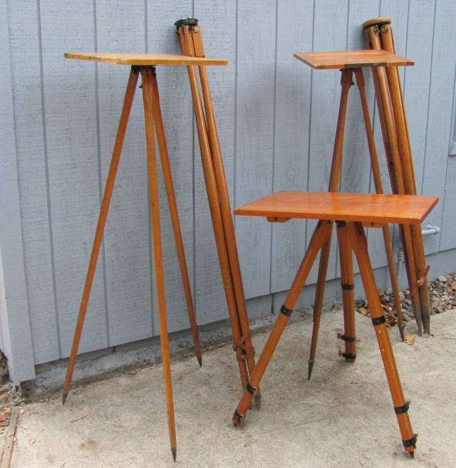

Syllabus
Plane Table Survey:
Introduction, principle, instruments, setting up the plane table, methods of plane tabling, advantages, sources of Errors.

Slide 3

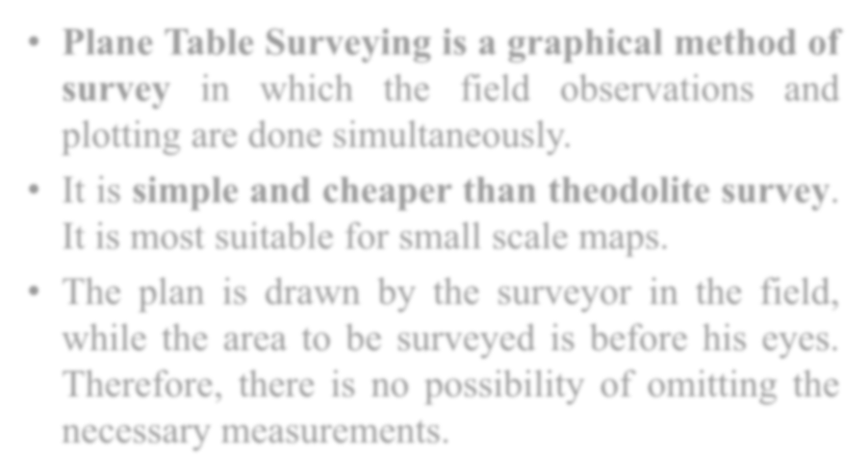

Plane Table Surveying
Plane Table Surveying is a graphical method of survey in which the field observations and plotting are done simultaneously.
It is simple and cheaper than theodolite survey. It is most suitable for small scale maps.
The plan is drawn by the surveyor in the field, while the area to be surveyed is before his eyes. Therefore, there is no possibility of omitting the necessary measurements.

Slide 4
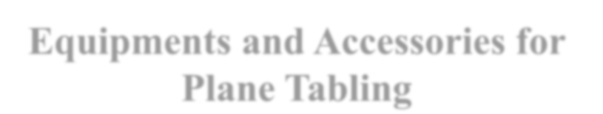
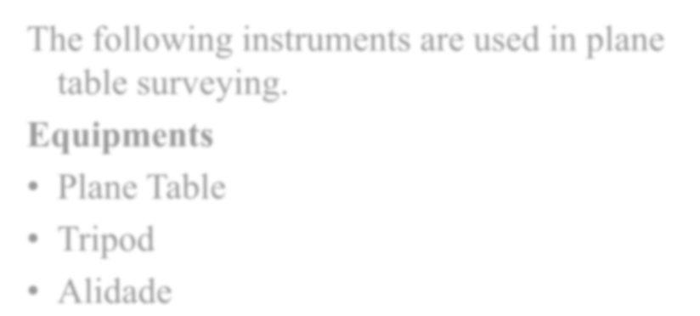
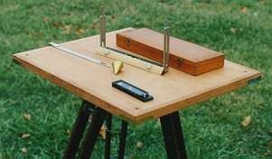

Equipments and Accessories for Plane Tabling
The following instruments are used in plane table surveying.
Equipments
Plane Table
Tripod
Alidade

Slide 5
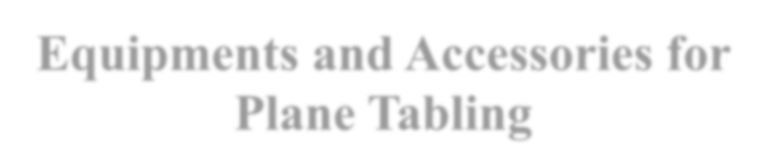
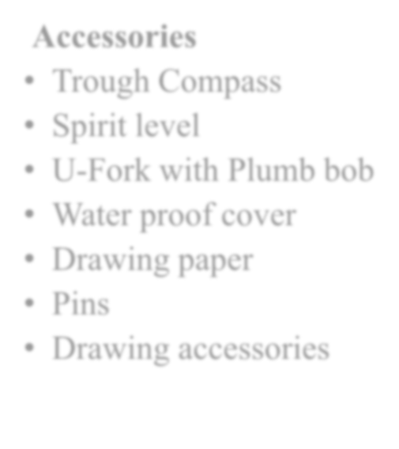
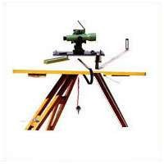

Equipments and Accessories for Plane Tabling
Accessories
Trough Compass
Spirit level
U-Fork with Plumb bob
Water proof cover
Drawing paper
Pins
Drawing accessories

Slide 6

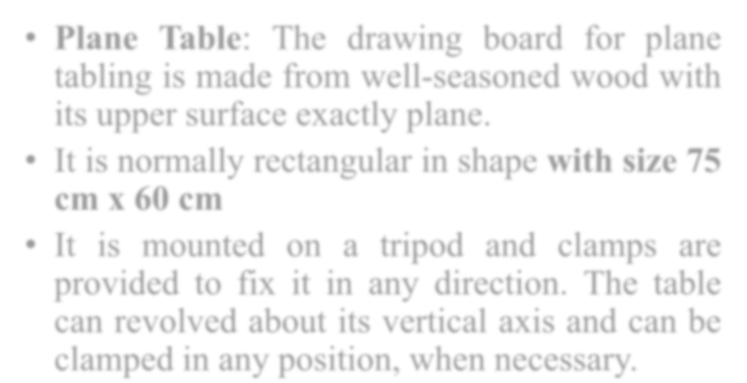
Equipments
Plane Table: The drawing board for plane tabling is made from well-seasoned wood with its upper surface exactly plane.
It is normally rectangular in shape with size 75 cm x 60 cm
It is mounted on a tripod and clamps are provided to fix it in any direction. The table can revolved about its vertical axis and can be clamped in any position, when necessary.

Slide 7

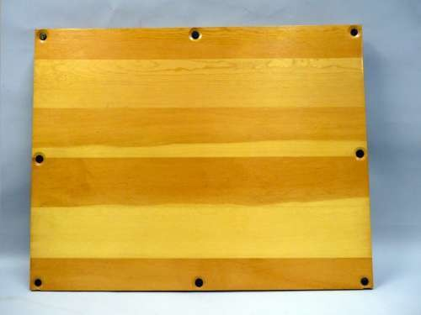

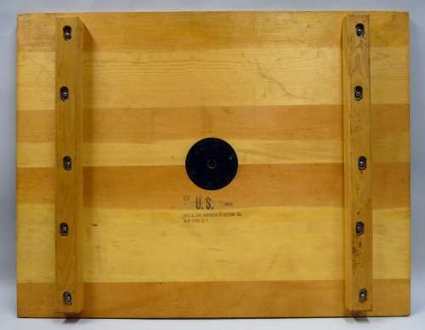

Plane Table

Slide 8

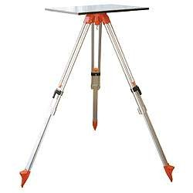

Plane Table

Slide 9

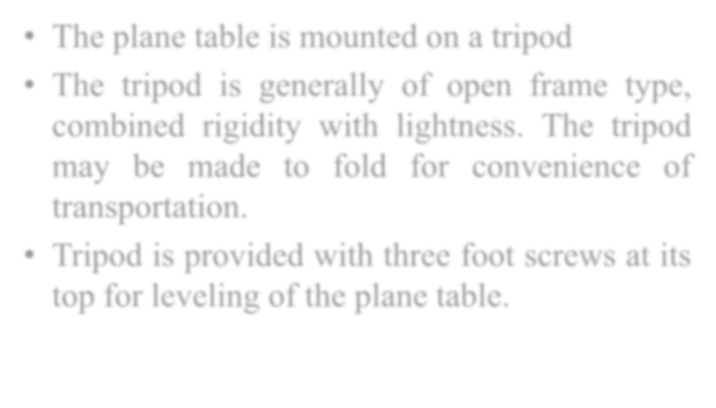
Tripod
The plane table is mounted on a tripod
The tripod is generally of open frame type, combined rigidity with lightness. The tripod may be made to fold for convenience of transportation.
Tripod is provided with three foot screws at its top for leveling of the plane table.

Slide 10

Tripod

Slide 11

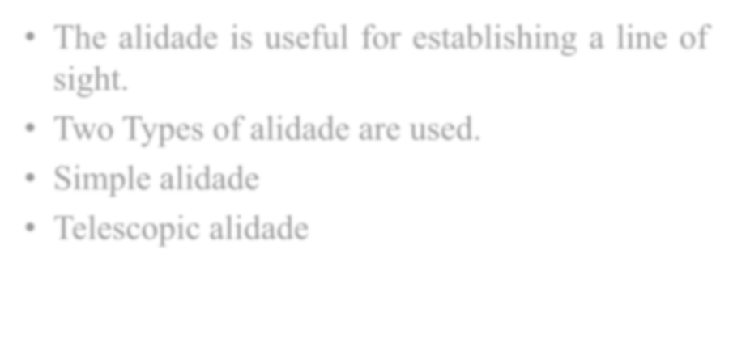

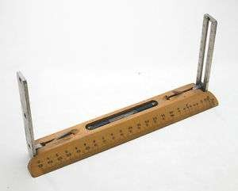

Alidade
The alidade is useful for establishing a line of sight.
Two Types of alidade are used.
Simple alidade
Telescopic alidade

Slide 12

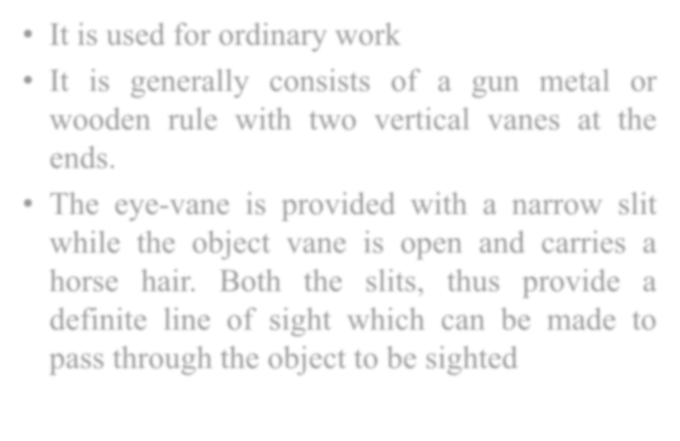

Simple Alidade
It is used for ordinary work
It is generally consists of a gun metal or wooden rule with two vertical vanes at the ends.
The eye-vane is provided with a narrow slit while the object vane is open and carries a horse hair. Both the slits, thus provide a definite line of sight which can be made to pass through the object to be sighted

Slide 13

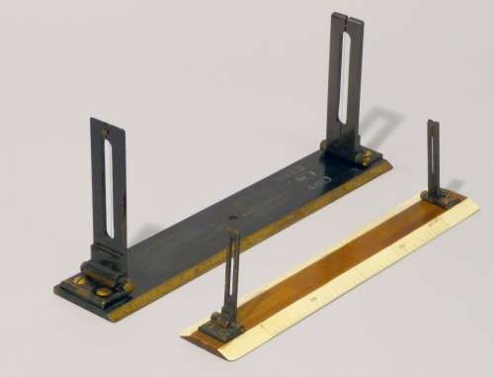

Simple Alidade

Slide 14

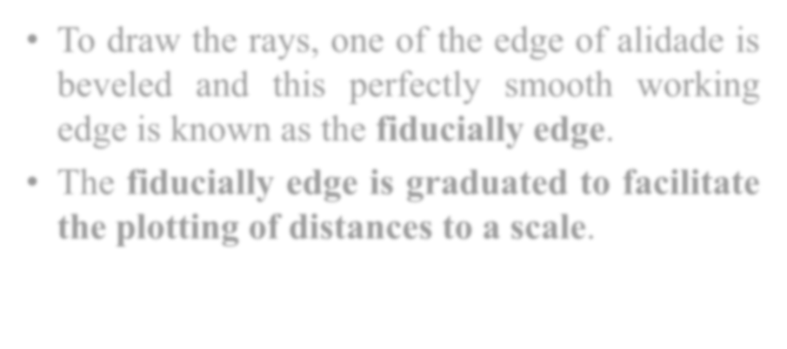
Simple Alidade
To draw the rays, one of the edge of alidade is beveled and this perfectly smooth working edge is known as the fiducially edge.
The fiducially edge is graduated to facilitate the plotting of distances to a scale.

Slide 15
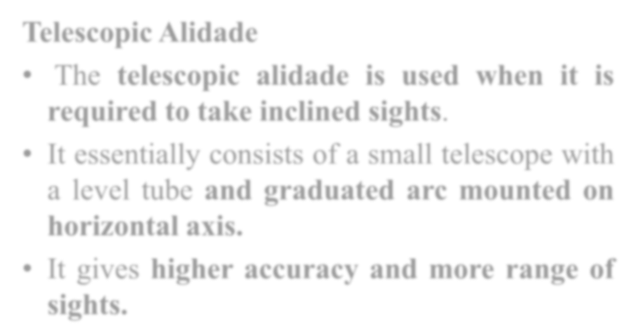

Telescopic Alidade
The telescopic alidade is used when it is required to take inclined sights.
It essentially consists of a small telescope with a level tube and graduated arc mounted on horizontal axis.
It gives higher accuracy and more range of sights.

Slide 16

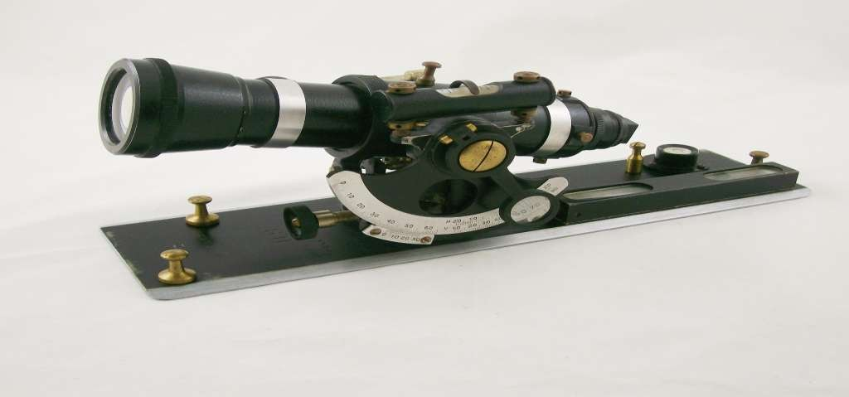

Telescopic Alidade

Slide 17

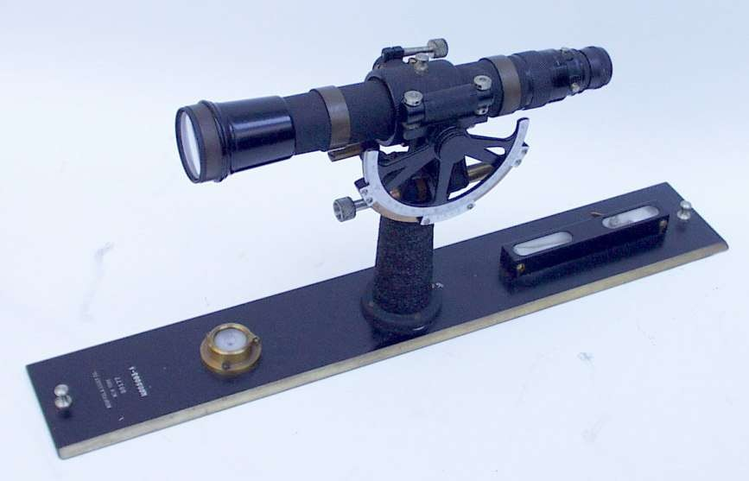

Telescopic Alidade

Slide 18

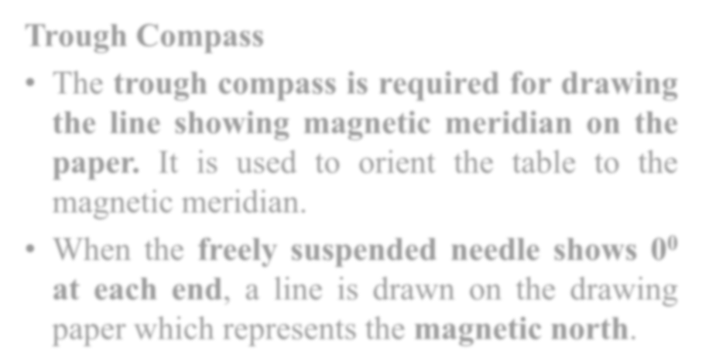
Accessories
Trough Compass
The trough compass is required for drawing the line showing magnetic meridian on the paper. It is used to orient the table to the magnetic meridian.
When the freely suspended needle shows 0⁰ at each end, a line is drawn on the drawing paper which represents the magnetic north.

Slide 19

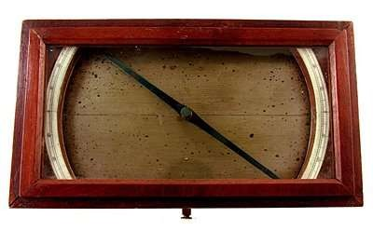

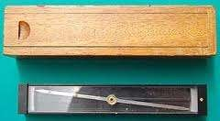

Trough Compass

Slide 20

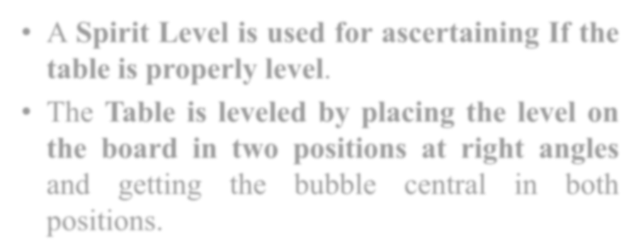
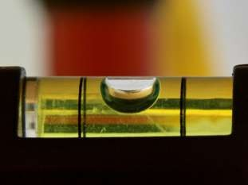

Spirit Level
A Spirit Level is used for ascertaining If the table is properly level.
The Table is leveled by placing the level on the board in two positions at right angles and getting the bubble central in both positions.

Slide 21
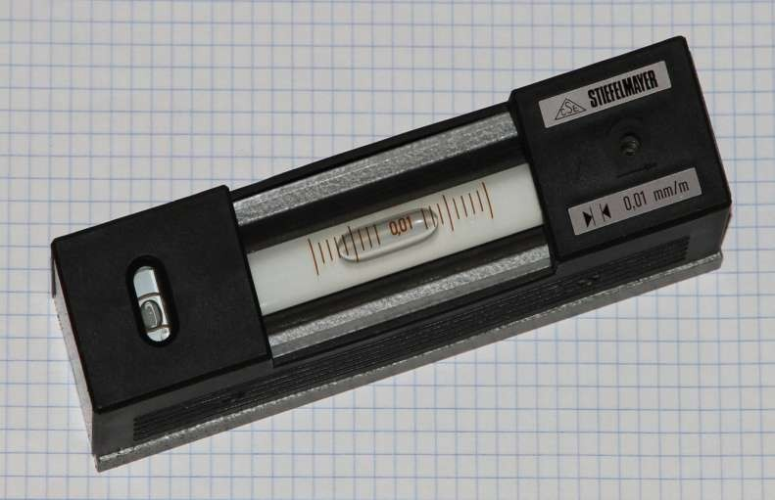

Spirit Level

Slide 22

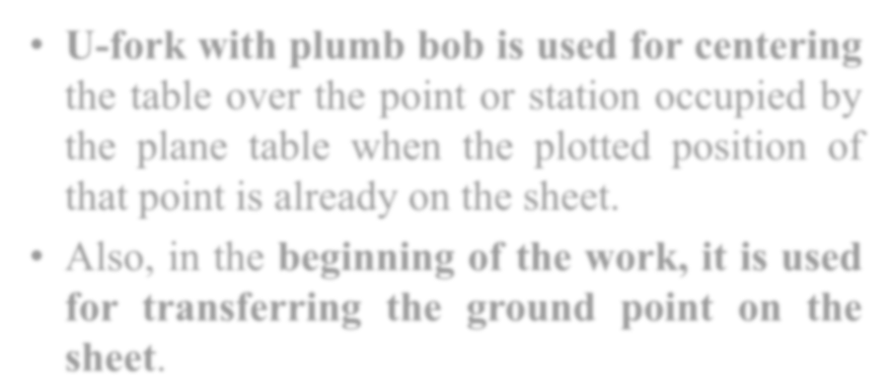
U-Fork With Plumb bob
U-fork with plumb bob is used for centering the table over the point or station occupied by the plane table when the plotted position of that point is already on the sheet.
Also, in the beginning of the work, it is used for transferring the ground point on the sheet.

Slide 23

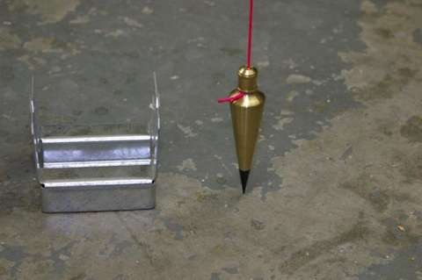

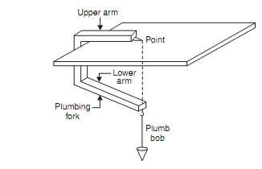

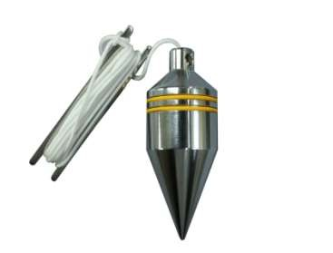

U-Fork With Plumb Bob

Slide 24

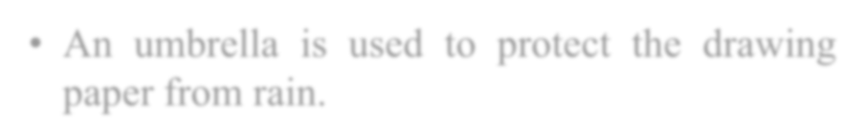


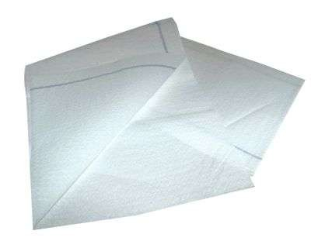

Water Proof Cover
An umbrella is used to protect the drawing paper from rain.

Slide 25

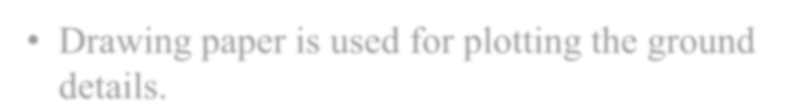
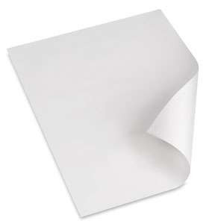

Drawing Paper
Drawing paper is used for plotting the ground details.

Slide 26
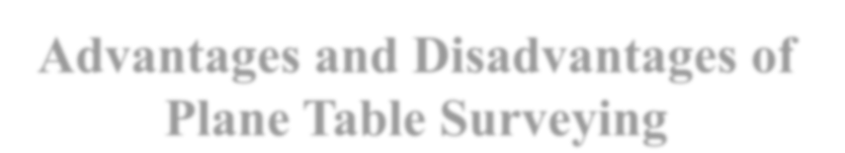
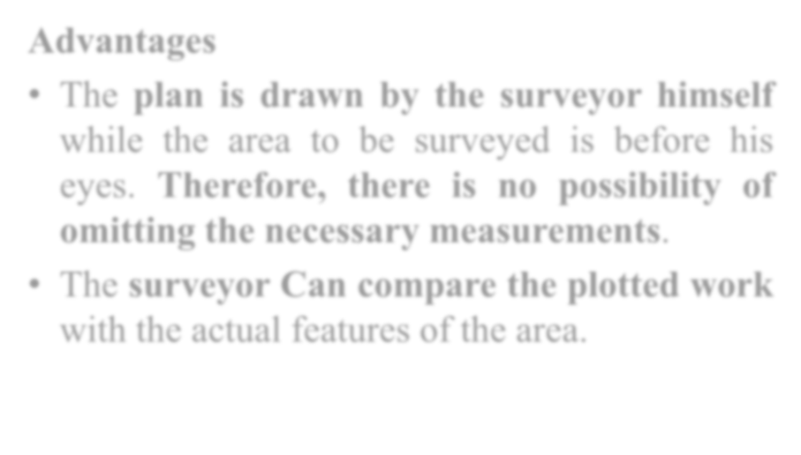
Advantages and Disadvantages of Plane Table Surveying
Advantages
The plan is drawn by the surveyor himself while the area to be surveyed is before his eyes. Therefore, there is no possibility of omitting the necessary measurements.
The surveyor Can compare the plotted work
with the actual features of the area.

Slide 27
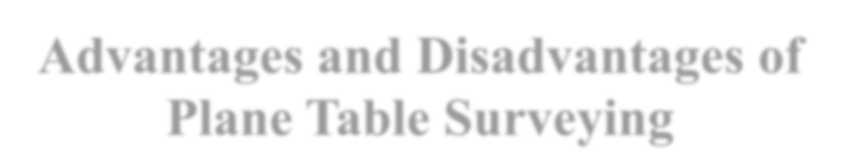
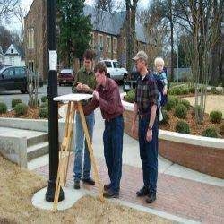

Advantages and Disadvantages of Plane Table Surveying

Slide 28

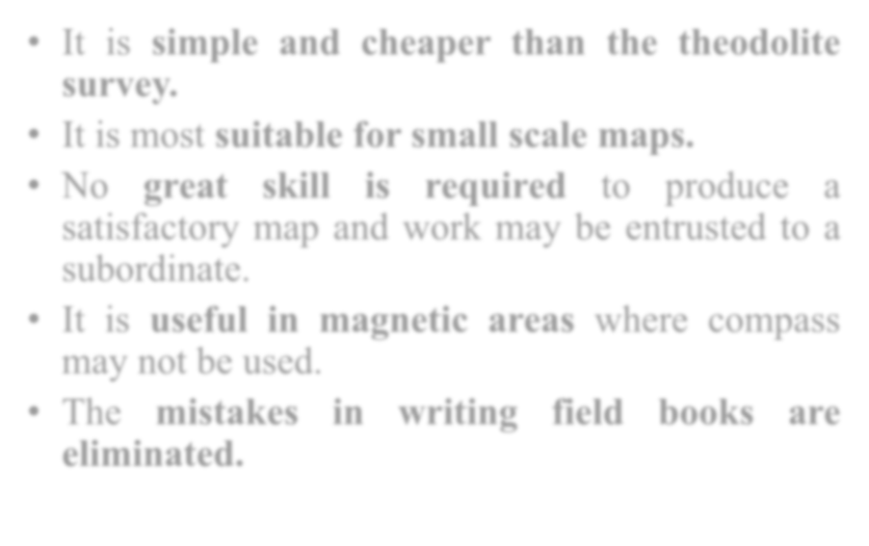

Advantages
It is simple and cheaper than the theodolite survey.
It is most suitable for small scale maps.
No great skill is required to produce a satisfactory map and work may be entrusted to a subordinate.
It is useful in magnetic areas where compass may not be used.
The mistakes in writing field books are eliminated.

Slide 29
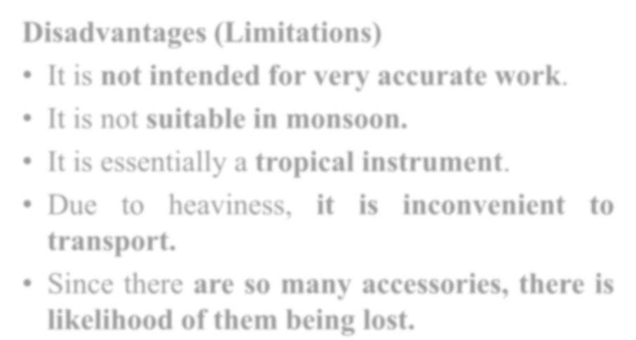
Advantages and Disadvantages of Plane Table Surveying
Disadvantages (Limitations)
It is not intended for very accurate work.
It is not suitable in monsoon.
It is essentially a tropical instrument.
Due to heaviness, it is inconvenient to transport.
Since there are so many accessories, there is likelihood of them being lost.

Slide 30
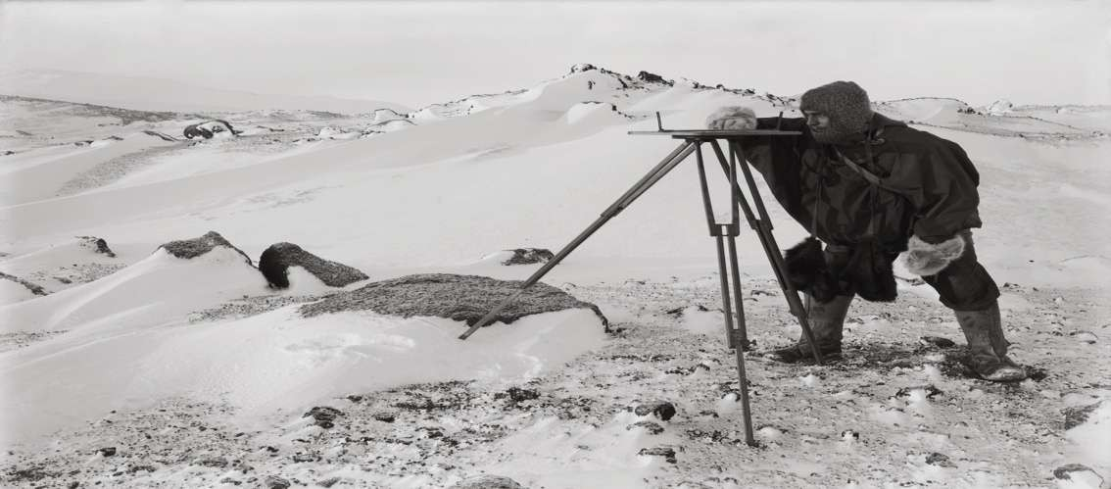

Advantages and Disadvantages of Plane Table Surveying

Slide 31

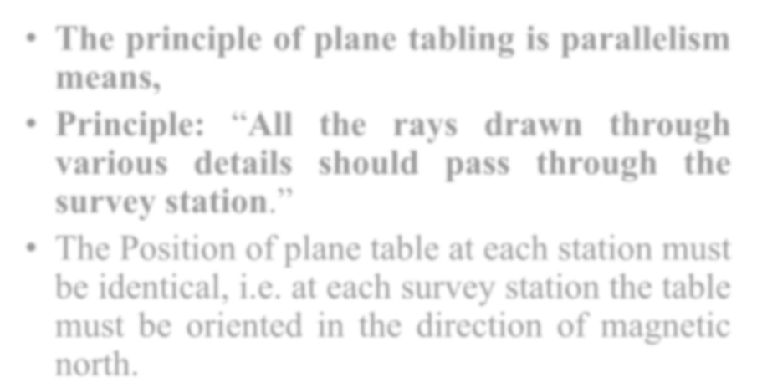
Principle Of Plane Table Survey
The principle of plane tabling is parallelism means,
Principle: “All the rays drawn through various details should pass through the survey station.”
The Position of plane table at each station must be identical, i.e. at each survey station the table must be oriented in the direction of magnetic north.

Slide 32

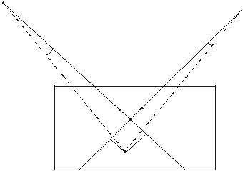

Principle Of Plane Table Survey

Slide 33

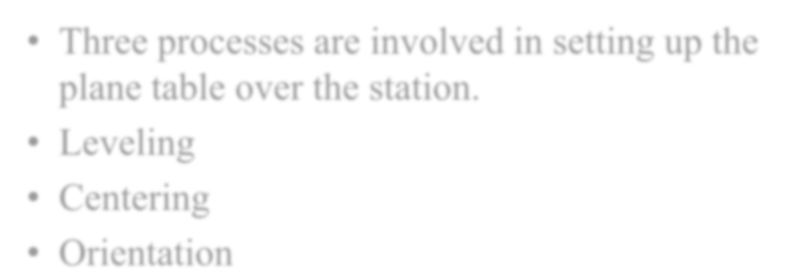
Method Of Setting Up The Plane Table
Three processes are involved in setting up the plane table over the station.
Leveling
Centering
Orientation

Slide 34

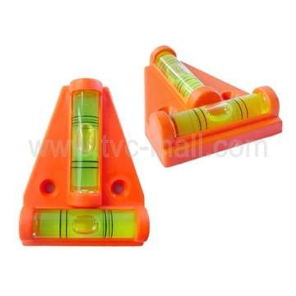

Leveling

Slide 35

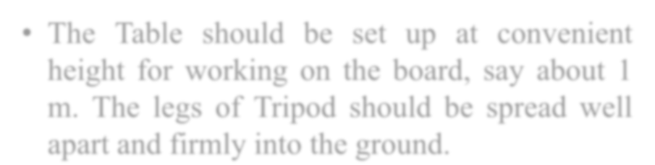
Leveling and Centering
The Table should be set up at convenient height for working on the board, say about 1
m. The legs of Tripod should be spread well apart and firmly into the ground.

Slide 36

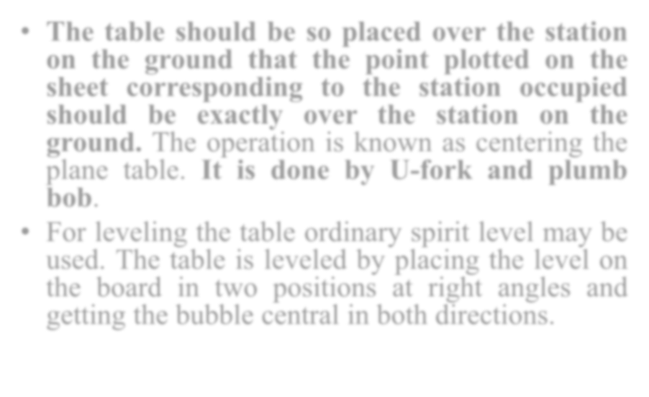
Leveling and Centering
The table should be so placed over the station on the ground that the point plotted on the sheet corresponding to the station occupied should be exactly over the station on the ground. The operation is known as centering the plane table. It is done by U-fork and plumb bob.
For leveling the table ordinary spirit level may be used. The table is leveled by placing the level on the board in two positions at right angles and getting the bubble central in both directions.

Slide 37

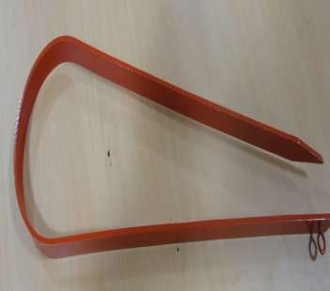





Centering

Slide 38


Orientation
The Process by which the positions occupied by the board at various survey stations are kept parallel is known as the orientation. Thus, when a plane table is properly oriented, the lines on the board are parallel to the lines on ground which they represent.
There are two methods of orientation:
By magnetic needle
By back sighting

Slide 39


By Magnetic Needle
In this method, the magnetic north is drawn on paper at a particular station. At the next station, the trough compass is placed along the line of magnetic north and the table is turned in such a way that the ends of magnetic needle are opposite to zeros of the scale. The board is then fixed in position by clamps. This method is inaccurate in the since that the results are likely to be affected by the local attraction.

Slide 40



Orientation

Slide 41


By Back Sighting
A= First survey station
B= Second survey station
Suppose a line is drawn from station A on paper as ab, representing line AB on ground
The table is turned till the line of sight bisects the ranging rod at A. The board is then clamped in this position.
This method is better than the previous one and it gives perfect orientation.

Slide 42


Orientation

Slide 43


Methods Of Plane Tabling
There are four distinct tabling:
Method of Radiation
Method of Intersection
Method of Traversing
Method of Resection
methods of
plane

Slide 44


Radiation Method
In the radiation method of plane table surveying, the direction of the objects or points to be located are obtained by drawing radial lines along fiducially edge of alidade after getting the objects or points bisected along the line of sight of the alidade. The horizontal distances are then measured and scaled off on the corresponding radial lines to mark their positions on the drawing.

Slide 45

Radiation Method

Slide 46



Radiation Method
Suppose P is a station on the ground from where the object A, B, C and D are visible.
The plane table is set up over the station P. A drawing is fixed on the table, which is then leveled and centered. A point p is selected on the sheet to represent the station P.
The north line is marked on the right-hand top corner of the
sheet with trough compass or circular box compass.
With the alidade touching p, the ranging rod at A,B, C and D are bisected and the rays are drawn.
The distances PA, PB, PC and PD are measured and plotted to any suitable scale to obtain the points a, b, c and d representing A,B,C,D on paper.

Slide 47


Radiation Method

Slide 48



Method Of Intersection
In intersection method of plane table surveying, the objects or points to be located are obtained at the point of intersection of radial lines drawn from two different stations.
In this method, the plotting of plane table stations are to be carried out accurately. Checking is important and thus done by taking third sight from another station.
The intersection method is suitable when distances of objects are large or cannot be measured properly. Thus, this method is preferred in small scale survey and for mountainous regions.

Slide 49


Method Of Intersection
Suppose A and B are two station and P is the object on the far bank of a river. Now it is required to fix the position of P on the sheet by the intersection of rays, drawn from A and B.
The table is set up at A. It is leveled and centered so that a point a on the sheet is just over the station A. The north line is marked on the right- hand top corner, the Table is then clamped.
With the alidade touching a, the object P and the ranging rod at B are bisected, and rays are drawn through the fiducial edge on alidade,

Slide 50


Method Of Intersection

Slide 51

Method Of Intersection
The distance AB is measured and plotted to any suitable scale to obtain point b.
The table is shifted and centered over B and leveled properly. Now the alidade is placed along the line ba and orientation is done by back sighting
With the alidade touching b, the object P is bisected and a ray is drawn, suppose this ray intersects the previous rays at point p. the point p is the required plotted position of P

Slide 52

Method Of Intersection

Slide 53


Method Of Traversing
This method of plane table surveying is used to plot a traverse in cases stations have not been previously plotted by some other methods. In this method, traverse stations are first selected. The stations are plotted by method of radiation by taking back sight on the preceding station and a fore sight to the following station. Here distances are generally measured by tachometric method and surveying work has to be performed with great care.

Slide 54


Method Of Traversing
Suppose A,B,C,D are the traverse stations,
The table is set up at the station A, a suitable point a is selected on the sheet in such a way that the whole area may be plotted in the sheet. The table is centered, leveled and clamped. The north line is marked on the right-hand top corner of the sheet.
With the alidade touching point a the ranging rod at B is bisected and a ray is drawn. The distance AB is measured and plotted to any suitable scale.

Slide 55



Method Of Traversing

Slide 56

Method Of Traversing
The table is shifted touching point a the ranging rod at B is bisected and a ray is drawn. The distance is measured and plotted to any suitable scale.
The table is shifted and centered over B. It is then leveled, oriented by back sighting and clamped.
With the alidade touching point b, the ranging rod at C is bisected and ray is drawn. The distance BC is measured and plotted to the same scale.
The table is shifted and set up at C and the same procedure is repeated.
In this manner, all stations of the traverse are connected.

Slide 57

Method Of Traversing
Check lines. To check the accuracy of the plane table traverse, a few check lines are taken by sighting back to some preceding station.
Error of closure . If the traverse to be plotted is a closed traverse, the foresight from the terminating station should pass through the first station. Otherwise the amount by which plotted position of the first station on the foresight fails to close is designated as the error of closure. It is adjusted graphically, if the error is within permissible limits, before any further plotting works are done.

Slide 58

Method Of Traversing

Slide 59


Method of Resection
Resection is the process of determining the plotted position of the station occupied by the plane table, by means of sights taken towards known points, locations of which have been plotted.
There are four methods of resection.
By Compass
By back sighting
By two point problem
By three point problem

Slide 60


Method of Resection
Suppose It is required to establish a station at position P. Let us select two points A and B on the ground. The distance AB is measured and plotted to any suitable scale. The line AB is known as the “base line”
The table is set up at A. It is leveled, centered and oriented by bisecting the ranging rod at B. The table is then clamped.
With the alidade touching point a, the ranging rod at P is bisected and a ray is drawn. Then a point P₁ is marked on this way by estimating with the eye.

Slide 61


Method of Resection

Slide 62

Method of Resection
The table is shifted and centered in such a way that P₁ is just over P. It is then oriented by back- sighting the ranging rod at A.
With the alidade touching point b, the ranging rod at B is bisected and a ray is drawn. Suppose this ray intersects the previous ray at a point P. This point represents the position of the station P on the sheet. Then the actual position of the station is marked on the ground by U-fork and plumb-bob

Slide 63


By Compass
This method is used only for small scale or rough mapping.
Let A and B be two visible stations which have been plotted on the sheet as a and b. Let C be the instrument station to be located on the plan.
Set the table at C and orient it with compass. Clamp the table.
Pivoting the alidade about a, draw a ray towards A, as Similarly, pivoting the alidade about b, draw a ray towards B, as bb’, The intersection of aa’ and bb’ will give point c on the paper.

Slide 64


By Compass

Slide 65


The Two Point Problem
In this problem, two well-defined points whose positions have already been plotted on the plan are selected. Then, by perfectly bisecting these points, a new station is established at the required position.

Slide 66


The Two Point Problem
Suppose P and Q are two well-defined points whose positions are plotted on map as p and q. It is required to locate a new station at A by perfectly bisecting P and Q
An auxiliary station B is selected at a suitable position. The table is set up at B, and leveled and oriented by eye estimation. It is then clamped.
With the alidade touching p and q, the points P and Q are bisected and rays are drawn. Suppose these rays intersect at b

Slide 67


The Two Point Problem

Slide 68

The Two Point Problem
With the alidade centre on b, the ranging rod at A is bisected and rays is drawn. Then, by eye estimation, a point a ₁ is marked on this ray.
The table is shifted and centre on A with a₁ just over A. It is leveled and oriented by back sighting. With the alidade touching p, the point P is bisected and a ray is drawn. Suppose this ray intersects the line ba₁ at point a₁, as was assumed.

Slide 69


The Two Point Problem
With the alidade centered on a₁ the point Q is bisected and a ray is drawn. Suppose this ray intersects the ray bq at a point q₁. The triangle pqq₁ is known as the triangle of error, and is to be eliminated.
The alidade is placed along the line pq₁ and a ranging rod R is fixed at some distance from the table. Then, the alidade is placed along the line pq and the table is turned to bisect R. At this position the table is said to be perfectly oriented.
Finally, with the alidade centered on p and q, the points P and Q are bisected and rays are drawn. Suppose these rays intersect at a point a. This would represent the exact position of the required station A. Then the station A is marked on the ground.

Slide 70


The Three Point Problem
In this problem, three well defined points are selected, whose position have already been plotted on the map. Then, by perfectly bisecting these three well-defined points. A new station is established at the required position.
No auxiliary station is required in order to solve this problem. This table is directly placed at the required position. The problem may be solved by following methods
(a) Bessel’s method
(b) Mechanical Method
(c) The trial and error method

Slide 71


The Three Point Problem
The graphical method or Bessel’s method
(i) suppose A,B, and C are three well-defined points which have been plotted as a, b and c. Now it is required to locate a station at P.
(ii) The table is placed at the required station P and leveled. The alidade is placed along the line ca and the point A is bisected. The table is clamped. With the alidade in centre on C, the point B is bisected and rays is drawn

Slide 72



Bessel’s Method

Slide 73

The Three Point Problem
Again the alidade is placed along the line ac and the point C is bisected and the table is clamped. With the alidade touching a, the point B is bisected and a ray is drawn. Suppose this ray intersects the previous ray at a point d
The alidade is placed along db and the point B is bisected. At this position the table is said to be perfectly oriented. Now the rays Aa, Bb and Cc are drawn. These three rays must meet at a point p which is the required point on the map. This point is transferred to the ground by U-fork and plumb bob.

Slide 74

The Three Point Problem
The Mechanical Method
Suppose A, B and C are the three well-defined points which have been plotted on the map as a, b and c. It is required to locate a station at P.
The table is placed at P and leveled. A tracing paper is fixed on the map and a point p is marked on it.
With the alidade centered on P the points A, B and C are bisected and rays are drawn. These rays may not pass through the points a, b and c as the orientation is done approximately

Slide 75



The Mechanical Method

Slide 76

The Three Point Problem
Now a tracing paper is unfastened and moved over the map in such a way that the three rays simultaneously pass through the plotted positions a, b and c. Then the points p is pricked with a pin to give an impression p on the map. P is the required points on the map. The tracing paper is then removed.
Then the alidade is centered on p and the rays are drawn towards A, B and C. These rays must pass through the points a, b and c

Slide 77


The Three Point Problem
The method of Trial and error
Suppose a, B and C are the three well-defined points which have been plotted as a, b and c on the map. Now it is required to establish a station at P.
The table is set up at P and leveled. Orientation is done by eye estimation
With the alidade, rays Aa, Bb and Cc are drawn. As the orientation is approximately, the rays may not intersect at a point, but may form a small triangle the triangle of error.
To get the actual point, this triangle of error is to be eliminated. By repeatedly turning the table clockwise or anticlockwise. The triangle is eliminated in such a way that the rays Aa, Bb and Cc finally meet at a point p. This is the required point on the map. This point is transferred to the ground by U-fork and plumb bob.

Slide 78



The method of Trial and Error

Slide 79


Points to be kept in mind in plane tabling
The following points should be kept in mind while doing plane table survey.
1. Ground points shall be marked as A, B, C… etc. and plan. Points (on Paper) shall be marked as a, b, c etc.
2. The rays from survey stations to the objects shall be drawn by dashed line.
3. The alidade should be properly pivoted while sighting the objects

Slide 80




Points to be kept in mind in plane tabling

Slide 81

Points to be kept in mind in plane tabling
4. The first survey station and the scale of the map shall be so chosen that the entire area can be plotted on the paper.
5. While establishing magnetic north on the paper using trough compass, things causing local attraction shall be kept away of the table.
6. The Plane table should be clamped after centering and leveling. The table should be rotated at the time of orientation.

Slide 82


Error In Plane Tabling
The various sources of error may be classified as :
Instrumental errors
Errors in manipulation and sighting
Errors in plotting

Slide 83


Instrumental Errors
The surface of drawing board is not plane
The edge of alidade is not straight.
The object vane and sight vane are not perpendicular to the alidade.
The edge of alidade is not is not parallel to the line of sight.
The fixing clamp is not proper.

Slide 84


Errors In Manipulation And Sighting
Defective Leveling
Defective Sighting
Defective Orientation
Defective Centering
Movement of Board between sights

Slide 85


Errors in Plotting
Defective scale of map
Wrongly intersecting the rays drawn from two different stations.

Slide 86




Important Questions
List Of Instruments used in plane tabling and give their uses.
Give advantages and disadvantages of plane table survey.
List of methods of plane table survey and explain any one.
Explain the following methods of plane tabling.
  Method of intersection
  Method of traversing
Explain the method of intersection for plane table survey.
Explain the principle of plane table survey.
Give limitations of plane table survey.
What is orientation? Explain orientation by back sighting.
Explain the procedure of plain table survey.
Explain errors in plane table survey.

Slide 87






References
“Surveying and Levelling” Vol- I
Kanetkar and Kulkarni (2011)
“ Surveying” Vol- I
Dr. B.C. Punamia
“ Surveying and Leveling”
N.N. Basak

Slide 88






Thanks !

